Slide 1

Classification of Mushrooms (Edible/Poisonous) using Artificial Intelligence
617B
Team - Curious 4 AI
SACRED HEART UNIVERSITY
School of Computer Science & Engineering
The Jack Welch College of Business & Technology
Submitted To: Dr. Reza Sadeghi
Fall - 2022

Slide 2
Outline:
Title
Reference
Description
Research Question
Exploring Data
Modeling Data
Optimization
Evaluating Model
Conclusion
GitHub

Slide 3
References:
https://archive.ics.uci.edu/ml/datasets/mushroom
https://escholarship.org/uc/item/48r6d4z0
https://www.researchgate.net/publication/2633347_Extraction_of_Logical_Rules_From_Training_Data_Using_Backpropagation_Networks
https://www.sciencedirect.com/science/article/abs/pii/0004370289900465

Slide 4
TEAM DETAILS:
Name | Contact
Sarvani Konda (lead) | kondas2@mail.sacredheart.edu
Venkata Prasanth Pinaka | pinakav@mail.sacredheart.edu
Srikar Singam | singams2@mail.sacredheart.edu
Jayadev Varma Sri Kakarlapudi | srikakarlapudij@mail.sacredheart.edu

Slide 5
TEAM DESCRIPTION:
Sarvani Konda:
I have done my undergraduate in Information Technology and started my career in 2016. I've worked in the technology sector for over 5 years, throughout my career I have worked on Openstack, Kubernetes, Python, Golang, and other technologies related to cloud. I am an enthusiastic coder and enjoy using my skills to contribute to open-source projects.
Venkata Prasanth Pinaka:
I have completed my graduation in the stream of Computer Science and Engineering. I worked over 6 years as a developer in technologies like Oracle PLSQL and Spring boot in JAVA in a few prime organizations. I like collaborating with my team and solving the problem at hand. I enjoy researching topics and gaining knowledge.
Srikar Singam:
Enthusiastic and Driven engineer to learn and explore new things. Graduate student in Computer science at Sacred Heart University.

Slide 6
Jayadev Varma Sri Kakarlapudi:
I am Jayadev Varma Sri Kakarlapudi, undergraduate in Computer science engineering and worked with ADP as a software developer for almost 4 years. My interest to learn and explore more in my field of work led me here to pursue my graduation. I would like to work with people with great passion and dedication towards their work just like the bunch of people in this team.

Slide 7
Research Question
To classify mushrooms (North American Origin) into edible or poisonous in an easier way, different machine-learning/AI models can be used. In this study, we will examine the data and build different ML/AI models that will detect the edibility of a mushroom into edible or poisonous by its specifications like gill color, cap shape, etc using classifiers.

Slide 8
Data Exploration
With data exploration, analysts attempt to find patterns and details in large pools of data. Data exploration uses a mix of different manual and automated techniques and processes. Its function is not to sort all the data, but rather look specifically for the broad picture strokes that are evident within the data.
– Number of samples in the mushrooms data set is 8124
– Number of features considered are 22 (Eg: cap-shape, cap-color, gill-size, gill-color, habitat)
– The data type of all the features is String

Slide 9
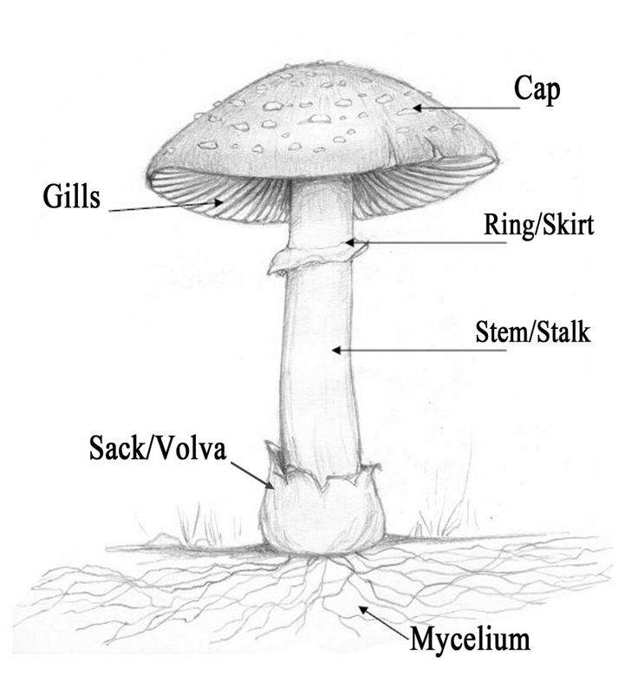
Dataset Description
From the image, we can say that we have 5 main features of the mushroom:
Cap: which is the top part of the mushroom from above, which takes the umbrella shape.
Gill: which is the underside of the cap
Ring: which is this little shape that surround the stem (stalk).
Stalk (Stem): is what makes the mushroom standing, it's this vertical cylindrical.
Veil (Volva): which is the bottom shape of the mushroom, that covers the bottom part of the mushroom.
There are other features that are included in the dataset, such as:
Bruises: Does the mushroom has bruises or not.
Spore Print Color: Shows the color of the mushroom spores.
Odor: Describes the smell or the odor of the mushroom.
Population: Shows what kind of populations that this mushroom grows.
Habitat: Shows where it lives.

Slide 10
Dataset Features
cap-shape cap-surface cap-color bruises odor gill-attachment gill-spacing gill-size gill-color stalk-shape stalk-root | 12. stalk-surface-above-ring 13. stalk-surface-below-ring 14. stalk-color-above-ring 15. stalk-color-below-ring 16. veil-type 17. veil-color 18. ring-number 19. ring-type 20. spore-print-color 21. population 22. Habitat

Slide 11
Data Exploration
There are some missing values observed in the data set.
– No duplicate values have been found in the data set across all features.
– In the feature ‘stalk-root’ = [‘e’ ‘c’ ‘b’ ‘r’ ‘?’] we see a value ‘?’. I means we have a missing value in this feature
– Using Imputation strategy we replace ‘?’ with ‘b’ because it has the most frequency in all the 2480 instances
– We used label-encoder to transform the feature values from string to integer as Scikit-learn’s algorithm can only be powered by integers or float values.

Slide 12
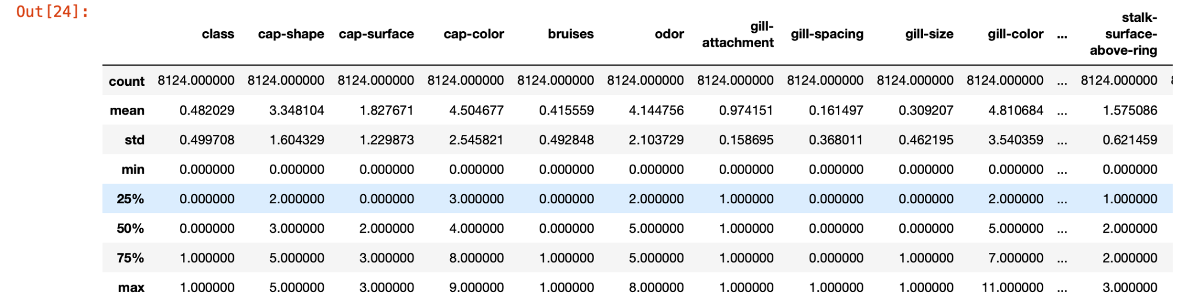
Data Exploration
– Descriptive analysis
– The highest mean is observed for ‘stalk-color-above-ring’ as 5.81

Slide 13
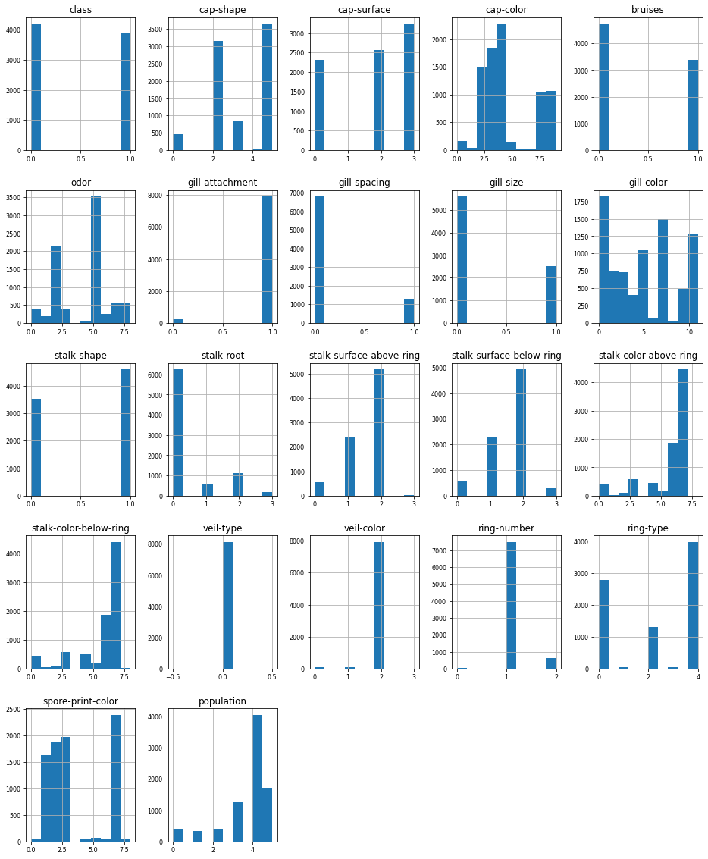
Data Exploration
It can be observed that the mushroom dataset is skewed, as histogram plots shown above are asymmetric.

Slide 14
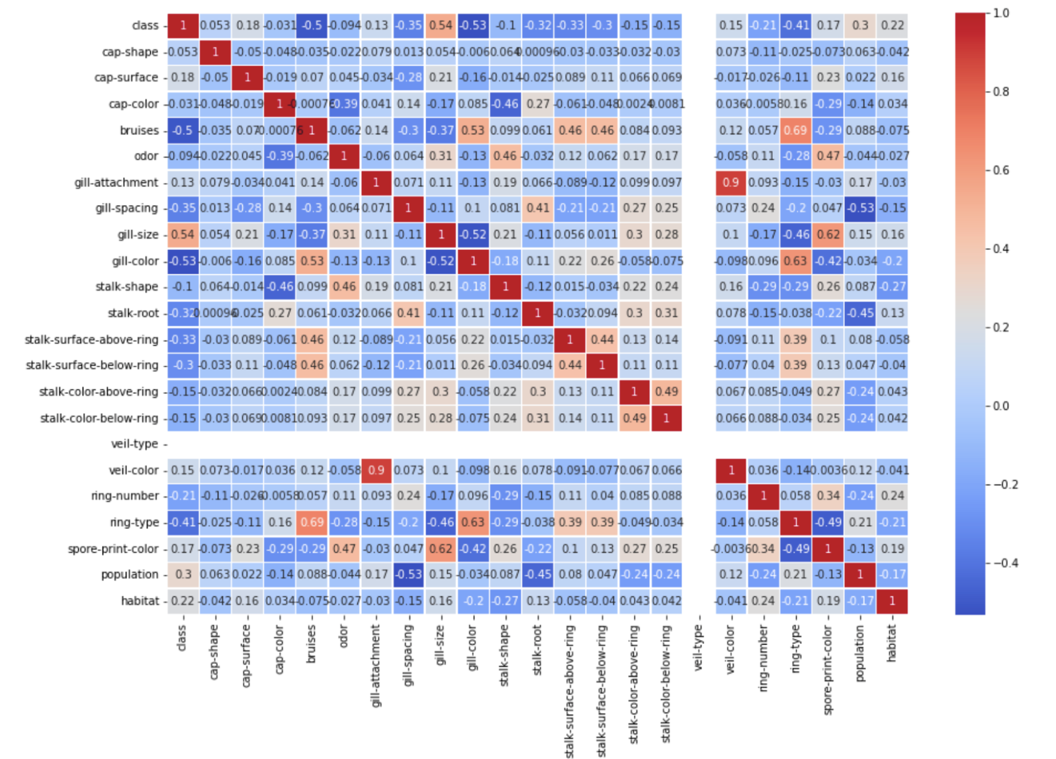
Data Exploration
From the below heatmap plot, it is observed that the feature veil-type is assigned a 0 value indicating that there is no relationship between veil-type and any other feature, and veil-color is highly correlated with the feature gill-attachment with the correlation value of a positive 0.9 which means if veil-color increases gill-attachment also increases.

Slide 15
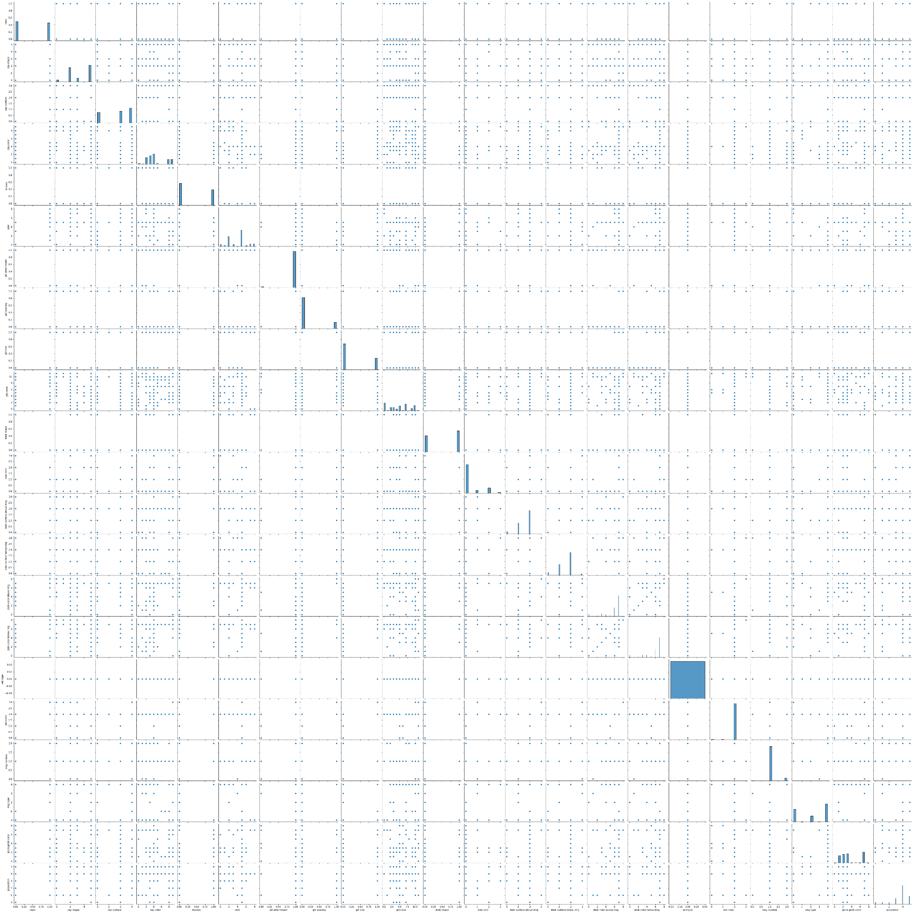
Data Exploration
Pair Plot:
From the pair plot, it is observed that cap-color and gill color are non linearly related when compared to other features

Slide 16
Modelling Data
In this phase, machine learning Algorithms are applied on the mushrooms dataset and are trained, tuned and applied on ML models.
The entire dataset is split into two sets, train and test in 80:20 ratio using the split function of the sklearn.
Train set size: 80% of dataset
Test set size: 20% of dataset
X_train size: (6499, 21)
X_test size: (1625, 21)
In this study we used three classifiers models Random Forest, K Nearest Neighbors and Decision Tree on the mushrooms dataset to predict the classification of the mushroom (edible/poisonous).

Slide 17
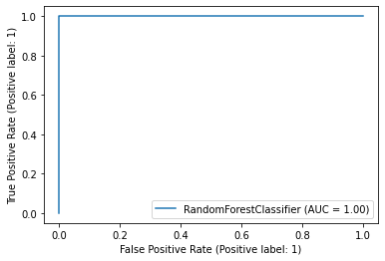
Model Evaluation
ROC for each model is plotted for the better understanding and to evaluate the model performance.
Random Forest Classifier
Accuracy: 100%
AUC: 1.00
The accuracy of RF 1.0
RF model details
precision recall f1-score support
0 1.00 1.00 1.00 842
1 1.00 1.00 1.00 783
accuracy 1.00 1625
macro avg 1.00 1.00 1.00 1625
weighted avg 1.00 1.00 1.00 1625
TN = 842, FP = 0, FN = 0, TP= 783

Slide 18
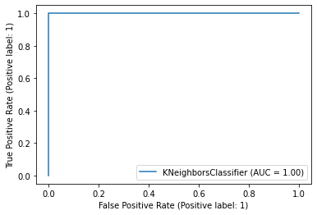
Model Evaluation
KNN ( K- Nearest Neighbors )
Accuracy : 100%
AUC: 1.00
The accuracy of KNN 1.0
KNN model details
precision recall f1-score support
0 1.00 1.00 1.00 842
1 1.00 1.00 1.00 783
accuracy 1.00 1625
macro avg 1.00 1.00 1.00 1625
weighted avg 1.00 1.00 1.00 1625
TN = 842, FP = 0, FN = 0, TP= 783

Slide 19

Model Evaluation
Decision Tree Classifier (DT)
Accuracy: 100%
AUC: 1.00
The accuracy of DT is 1.0
DT model details
precision recall f1-score support
0 1.00 1.00 1.00 842
1 1.00 1.00 1.00 783
accuracy 1.00 1625
macro avg 1.00 1.00 1.00 1625
weighted avg 1.00 1.00 1.00 1625
TN = 842, FP = 0, FN = 0, TP= 783

Slide 20
Optimization
For better performance cross validation of the dataset using the K-fold cross validation is done for all models.
Further, optimization of the hyper parameters is performed by randomized search using the RandomizedsearchCV().

Slide 21
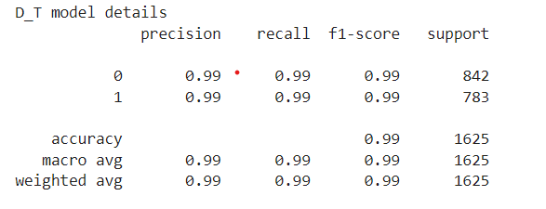
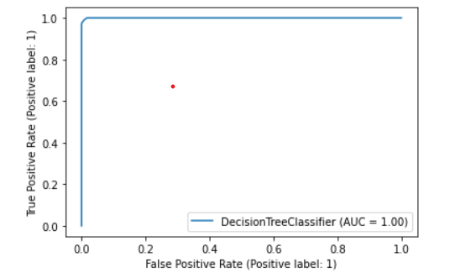
Model Evaluation
DT
Criteria: gini
Min_sample_leaf = 45
Min_sample_split = 114
Max_depth = 30
Accuracy = 99.3%
AUC = 1

Slide 22
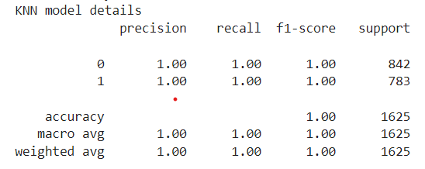
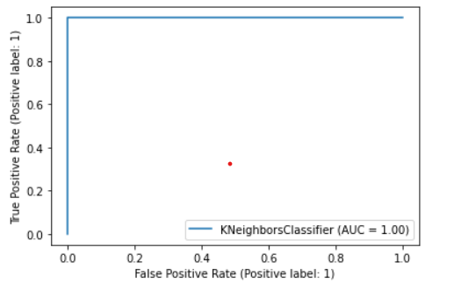
Model Evaluation
KNN
N_neighbour = 7
Algorithm = auto
Weights = distance
Accuracy = 99.98%

Slide 23
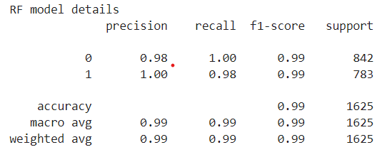
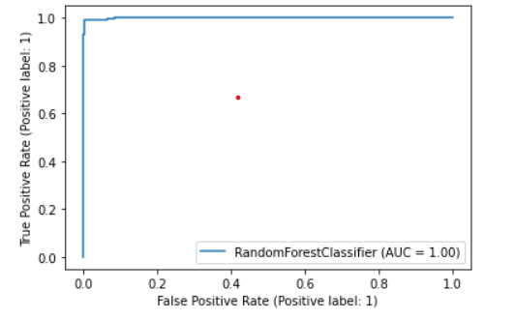
Model Evaluation
RF
N_estimators = 48
Min_sample_split = 5
Min_sample_leaf = 1
Max_depth = 4
Accuracy = 98.9%

Slide 24
Models Comparison:
Before optimization
SNO | Classification model | Accuracy
1 | KNN | 100
2 | RF | 100
3 | DT | 100
After optimization
SNO | Classification model | Accuracy
1 | KNN | 99.98
2 | RF | 98.90
3 | DT | 99.30

Slide 25
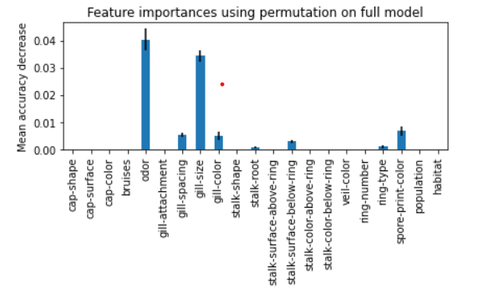
Feature Importance

Slide 26
Conclusion:
RF, KNN and DT are studied and experimented on the mushroom(North American mushrooms) dataset to classify the mushrooms into edible or poisonous.
The dataset exploration has proven that the data is skewed for all features and the target is balanced.
Even though all considered models have shown 100% accuracy before optimization after optimizing using ‘Randomized search cross validation’ the accuracy was slightly reduced to 99.3, 98.9 and 99.9 for Decision Tree, Random Forest and KNN respectively. As KNN has the best accuracy amongst the three models thus it’s a better model for the given Mushrooms dataset.
The feature importance using permutation for RF has shown that the ‘Odor’ feature has more importance than the rest, followed by ‘Gill Size’.

Slide 27
GitHub Repository
GitHub Repository Link

Slide 28
Thank You

